Slide 2
Optimal Survey Effort Allocation—Assume a stratification is specified
Univariate case: Neyman allocation
Multivariate case: Bethel Algorithm
The optimal stratum sample effort allocation is based on:
Total sample size: prespecified
Historical stratum sample variance
Stratum-cost of sampling
This is what is used in the GoA BTS
Optimal sampling is calculated for a set of representative species
Stratum allocations are determined by a weighted average of the species based on mean total biomass and ex-vessel value
The optimal stratum sample effort allocation is based on:
Stratum variance
Stratum-cost of sampling
Calculates optimum strata effort allocations given a CV constraint for each species
Can be used to compare stratifications

Slide 3

Optimal Strata Boundaries
Brute-force searches for optimal stratification are often intractable
Metaheuristics: partial search algorithms that may provide sufficiently good solutions to optimization problems
Globally solutions are not guaranteed but many metaheuristics can find good solutions with a reasonable amount of computational effort
Notes:
Searching for the optimum strata boundaries using a brute-force search is intractable for even fairly moderate problems. So using a meta-heuristic optimization is a feasible way to find a relatively good solution in a reasonable amount of computing time. The exact answer, or the global solution, are not guaranteed but many heuristics can search towards reasonable solutions.

Slide 4
Genetic algorithm: type of metaheuristic that takes inspiration from the process of natural selection
A population of solutions to the optimization problem evolves over generations towards better solutions
Notes:
The type of metaheuristic the SamplingStrata R package is a genetic algorithm, and takes it name from simulating the major processes of natural selection. A population of solutions to the optimization problem evolves over generations towards better solutions through the concepts of fitness (better solutions have a higher probability of passing on the traits of their solution), mutation (small changes in the solutions), and recombination (individual solutions mating and producing offspring solution that contain traits of the parents)

Slide 5
Initialize with 50 random stratifications (5 strata)
. . . .
P Generation
Notes:
The algorithm initiates with a population of solution consisting of random stratifications. In our problem, stratifications are defined by longitude and depth. Here we start with 50 individuals in the populations or candidate solutions. Each candidate solution expresses a variant of a trait (the trait being the stratification) and each candidate solution has a calculated fitness

Slide 6
Optimal Survey Effort Allocation—Assume a stratification is specified
Univariate case: Neyman allocation
The optimal stratum sample effort allocation is based on:
Total sample size: prespecified
Historical stratum sample variance
Stratum-cost of sampling
This is what is used in the GoA BTS
Optimal sampling is calculated for a set of representative species
Stratum allocations are determined by a weighted average of the species based on mean total biomass and ex-vessel value

Slide 7
Optimal Survey Effort Allocation—Assume a stratification is specified
Univariate case: Neyman allocation
Multivariate case: Bethel Algorithm
The optimal stratum sample effort allocation is based on:
Total sample size: prespecified
Historical stratum sample variance
Stratum-cost of sampling
This is what is used in the GoA BTS
Optimal sampling is calculated for a set of representative species
Stratum allocations are determined by a weighted average of the species based on mean total biomass and ex-vessel value
The optimal stratum sample effort allocation is based on:
Stratum variance
Stratum-cost of sampling
Calculates optimum strata effort allocations given a CV constraint for each species
Can be used to compare stratifications
CV Constraints
Bethel Algorithm
Optimal Total Sample Size
Stratification

Slide 8
Initialize with 50 random stratifications (5 strata)
Given a CV constraint, calculate optimal total sample size (fitness score) across strata for each solution
. . . .
P Generation
N = 300
N = 56
N = 120
Stratification is a “trait” that exhibits “variation”
Each stratification is associated with a fitness → fitness is variable
Notes:
which is optimal total sample size as calculated by the Bethel algorithm. The lower the total sample size, the fitter the solution because this is a minimization problem.

Slide 9
Initialize with 50 random stratifications
Given a CV constraint, calculate optimal total sample size (fitness score) across strata for each solution
. . . .
P Generation
N = 300
N = 56
N = 120
Create 50 new solutions based on the fitness scores of the current generation
Save a subset of the best solutions (Elitism)
Recombination: randomly “mate” two solutions with probability proportional to fitness score
Random mutations of strata boundaries
Notes:
In the next generation, a few things happen. First a subset of the best solutions (the rate of which is user-defined) is immediately passed on to the next population, this is called elitism. Solutions are allowed to “mate” and “cross over” information about stratification boundaries. Then, random mutations in the stratification boundaries occur at some user-defined rate.

Slide 10
Initialize with 50 random stratifications
Given a CV constraint, calculate optimal total sample size (fitness score) across strata for each solution
. . . .
P Generation
N = 300
N = 56
N = 120
Create 50 new solutions based on the fitness scores of the current generation
Save a subset of the best solutions (Elitism)
Recombination: randomly “mate” two solutions with probability proportional to fitness score
Random mutations of strata boundaries
. . . .
F1 Generation
Notes:
And a new generation of solutions is created from those genetic processes. The fitness of each solution is calculated for each solution in this new generation and the process repeats.

Slide 11
Initialize with 30 random stratifications
Given a CV constraint, calculate optimal total sample size (fitness score) across strata for each solution
. . . .
P Generation
N = 300
N = 56
N = 120
Create 30 new solutions based on the performance of the candidate solutions
Save a subset of the best solutions (Elitism)
Recombination: randomly “mate” two solutions with probability proportional to fitness core
Random mutations of strata boundaries
. . . .
F1 Generation
. . .
Calculate optimal allocation of total effort (fitness score) across strata for each solution.
Repeat for as many generations as user-specified
. . . .
F300 Generation
Calculate best solution in the last generation and designate as the optimal solution
Notes:
The search is terminated after a prespecified number of generations and the best solution in the last generation is determined as the optimal solution

Slide 12
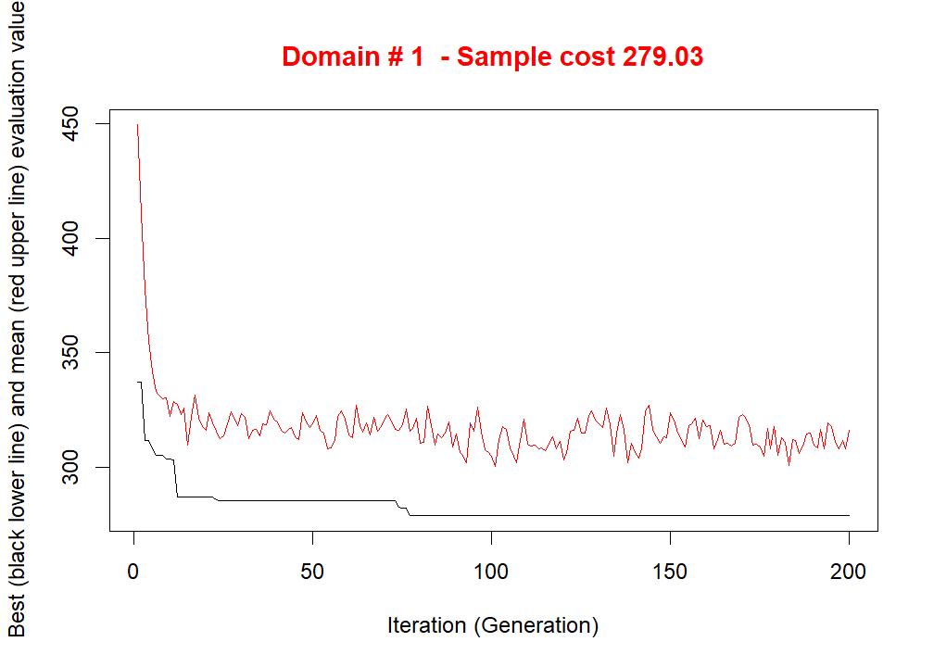
average
Total Sample Size
best
Notes:
This is an example of the progress of the population of solutions over generation. The red line is the average fitness score of the population and the black line is the best fitness score within a generation. So within 25 generations, the solutions rapidly increase in fitness and over generation time, the average and best fitness scores asymptote to an optimal solution.

Slide 13
solution <- optimStrata(
framesamp = frame, #Main data input
errors = cv, #CV constraints (ceiling)
iter = 200, #Number of iterations or generations
pops = 30, #Number of candidate solutions in the “population”
elitism_rate = 0.1, #Elitism Rate
mut_chance = 0.1, #Mutation Rate
nStrata = 10) #Number of strata in each solution
Notes:
The optimStrata is the function used to set up the optimization. Here are some useful arguments of that function.

